Slide 1



Matchmaking for Online Games and Other Latency-Sensitive P2P Systems
Sharad Agarwal and Jacob R. Lorch

Slide 2





Game matchmaking
134.70.81.213, 152.3.9.124, 14.14.91.3, 216.36.6.1
Key exchange
server
client
Latency measurement
Often you won’t find the closest potential match
Annoyingly sluggish games!
NAT-busting
Bandwidth measurement
134.70.81.213

Slide 3

Latency prediction
Notes:
Say probing is necessary to test connectivity and bandwidth, and to check for prediction errors.

Slide 4
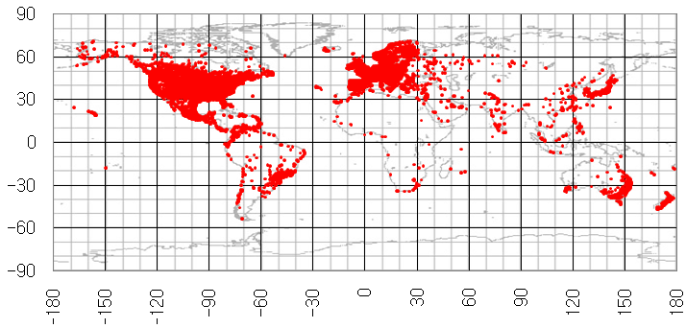
Extensive matchmaking trace
30
3,500,000
50,000,000
days
machines
probes
Notes:
Say “from Bungie”. Emphasize that these are home machines, not PlanetLab.

Slide 5



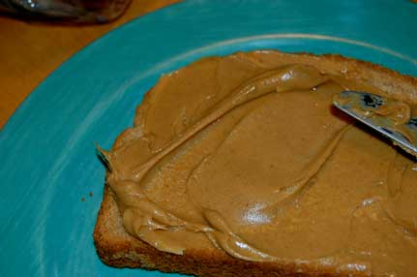
Current approaches
Htrae
Geolocation
Network coordinate systems
accurate, immediate
accurate, immediate, network-aware, adaptive
network-aware, adaptive
Notes:
Explain peanut butter and jelly.

Slide 6

Other applications

Slide 7


Other applications

Slide 8
Other applications

Slide 9
Outline
Motivation
Overview
Background
Design
Evaluation
Related work
Concluding remarks

Slide 10
Outline
Motivation
Overview
Background
Design
Evaluation
Related work
Concluding remarks

Slide 11

Geolocation
131.76.10.75
236 ms
6,410 miles

Slide 12

Network coordinate systems: Vivaldi
A
45 ms
20 ms
B
A
30 ms
B
?
?
Notes:
Don’t belabor the point of the coordinate system being not grounded in reality. Mention that 2-D is a simplification for presentation.

Slide 13

Vivaldi
Pyxida:
Vivaldi, modified based on experience with 1,000,000+ machines
Notes:
Say “non-dimensional”, not “extra-dimensional”.

Slide 14
Outline
Motivation
Overview
Background
Design
Evaluation
Related work
Concluding remarks

Slide 15
Design
Geographic bootstrapping
Autonomous system corrections
Symmetric updates
Triangle inequality violation avoidance

Slide 16
Weaknesses of current approaches
Geolocation
Network coordinate systems
slow convergence
non-geometric topology
incorrect geolocation
finds local minimum
inflexible
sensitive to initial conditions
Notes:
Describe in a punchier way (not so verbosely).

Slide 17
Geographic bootstrapping
?
131.76.10.75
Notes:
“We also use the standard non-dimensional coordinate, height, to reflect the fact that nodes have certain latency, such as access-link latency, that is common to all their paths no matter which direction they go.” Emphasize geolocation is used only at initialization, and only for yourself.

Slide 18
Geographic bootstrapping
Accurate local initialization
?
Flexible
Avoids poor global embedding
Notes:
“When we start hill-climbing, we’re more likely on a nice tall mountain.”

Slide 19
Autonomous system corrections
1
239
34
25
?
779
20%
131.76.10.75
height
25
Notes:
Say “data set”, not “database” of ASes.

Slide 20
Symmetric updates
B
A
B
A
Notes:
It improves convergence, leading to better steady-state accuracy. Anecdotally others have done this before; we are the first to present it in a paper and thoroughly evaluate it.

Slide 21
Outline
Motivation
Overview
Background
Design
Evaluation
Related work
Concluding remarks

Slide 22
Methodology: trace replay
30
3,500,000
50,000,000
33
days
machines
probes
Deduce parameters of predictors from a different training data set

Slide 23
Methodology: trace replay
5.19.102.34
87 ms
89.10.32.105
102.90.1.9
75 ms
65.65.65.65
108 ms
76 ms
102 ms
93 ms
301 ms
230 ms
3.141. 59.5

Slide 24
Evaluation, part 1:
How far off are latency predictions?

Slide 25
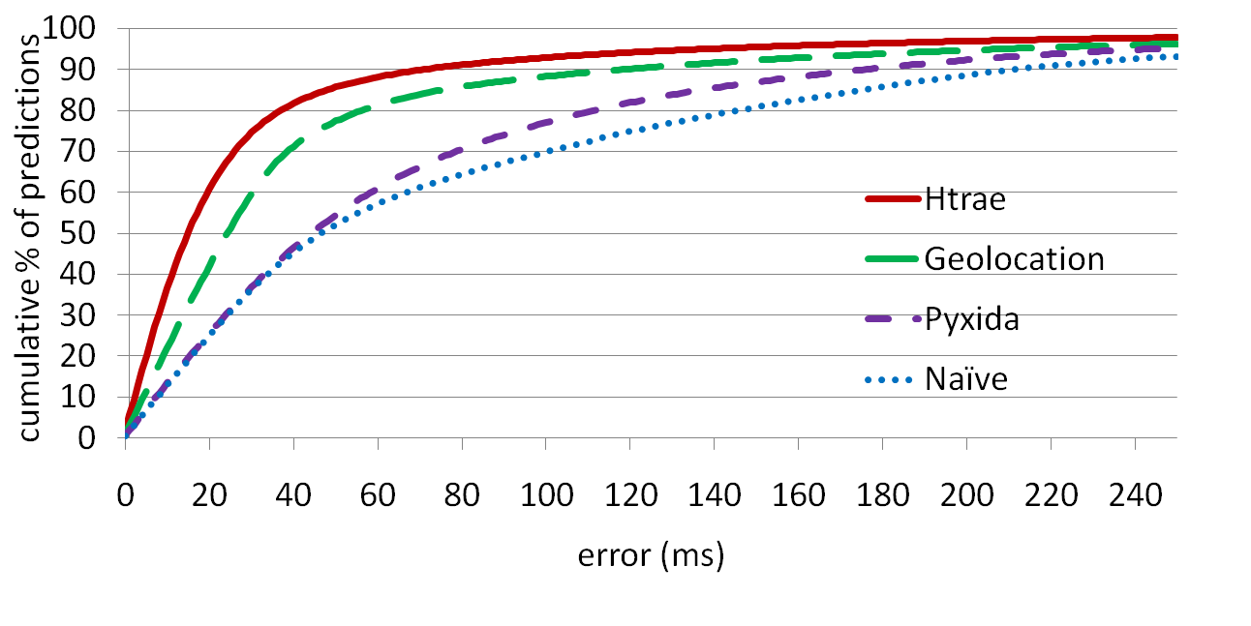
Absolute error
The “Naïve” predictor always guesses the average
Median: Htrae 15 ms, Geolocation 24 ms, Pyxida 44 ms
Pyxida frequently has to guess due to lack of data
95th quantile: Htrae 138 ms, Geolocation 208 ms, Pyxida 244 ms
Notes:
Get more familiar with numbers so it flows better.

Slide 26
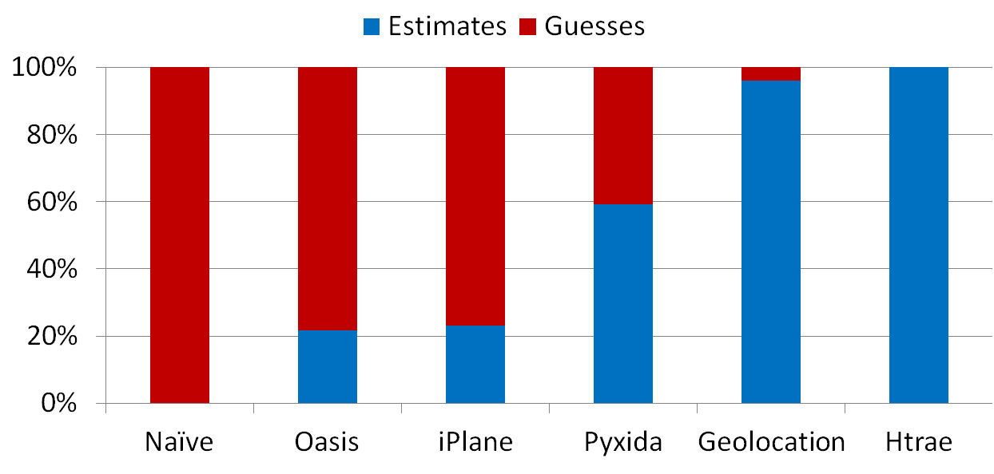
Waiting for information

Slide 27
Evaluation, part 2:
How effective are predictors at finding the best server for a client?

Slide 28
Best-server error
76 ms
33 ms
108 ms
210 ms
117 ms
132 ms
100 ms
132 ms
100 ms
213 ms
t_{chosen}-t_{best}
Best-server error: 32 ms

Slide 29
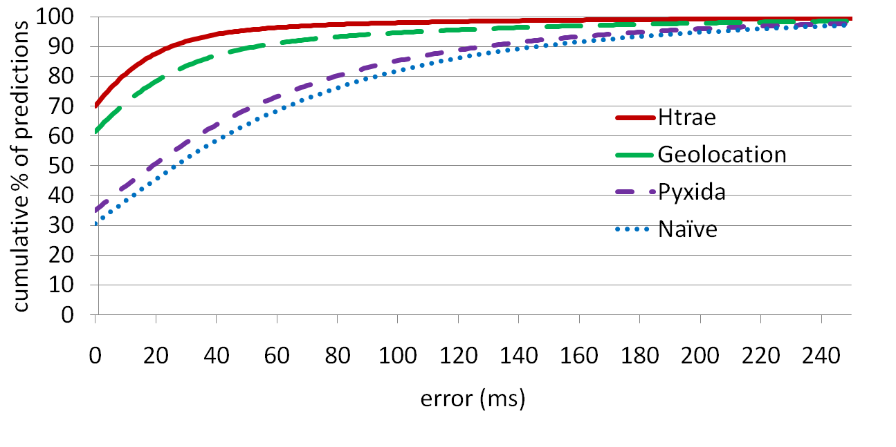
Best-server error
Frequency of correct server choice: Htrae 70%, Geolocation 61%, Pyxida 35%
95th quantile: Htrae 46 ms, Geolocation 105 ms, Pyxida 183 ms

Slide 30


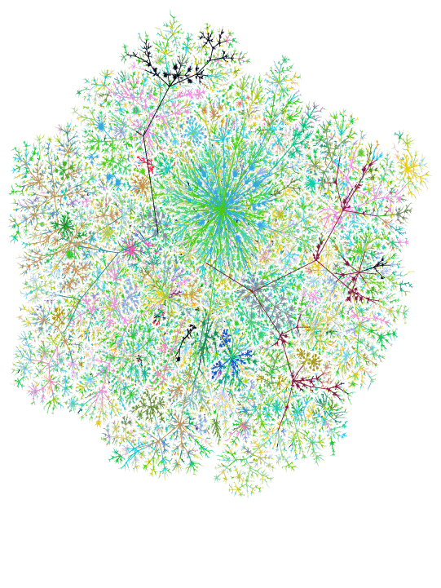
Comparison to deployed systems
– geolocation to find closest server
iPlane – Internet topology modeling
8
10
10
10
12
12
1
5
3
4
8
14
14
9
6
10
2
3
5
7
5
11
1
6
2
6
1
3
5
4
5
6
4
4

Slide 31
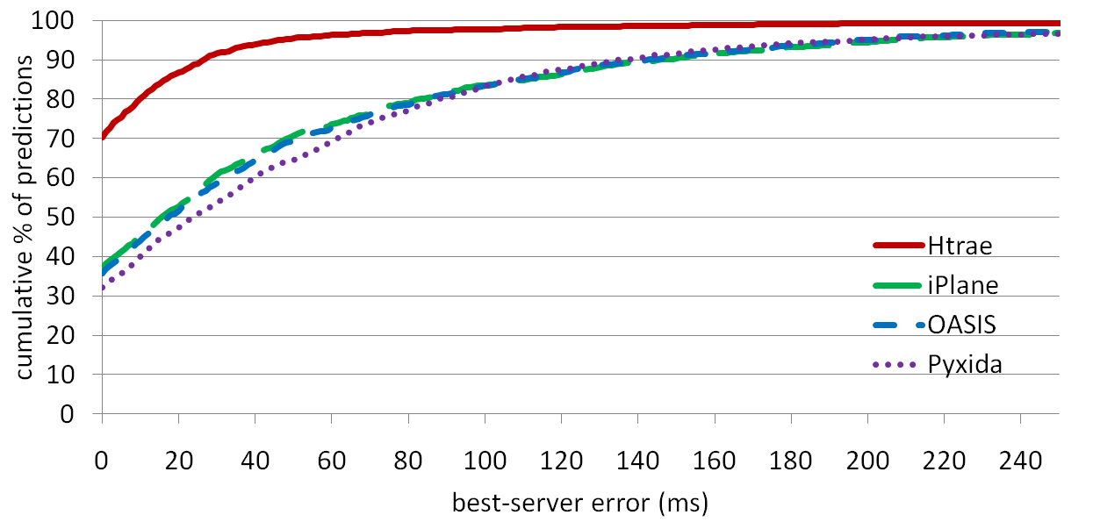
Comparison to deployed systems
Deployed systems have to guess a lot

Slide 32
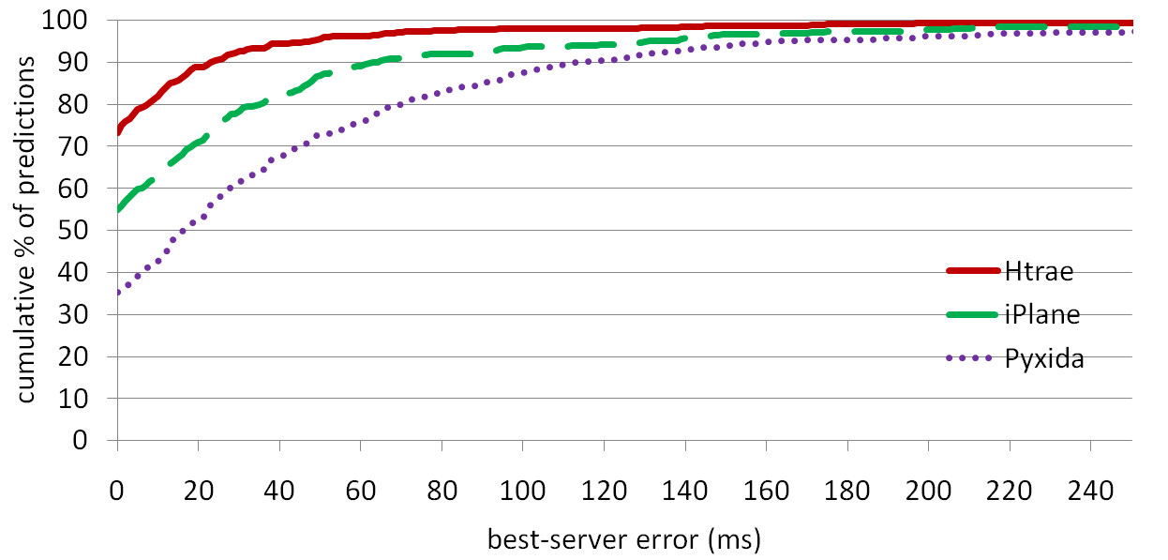
Comparison to deployed systems
Only considering address pairs iPlane makes a prediction for
iPlane suffers from lack of node-specific data

Slide 33
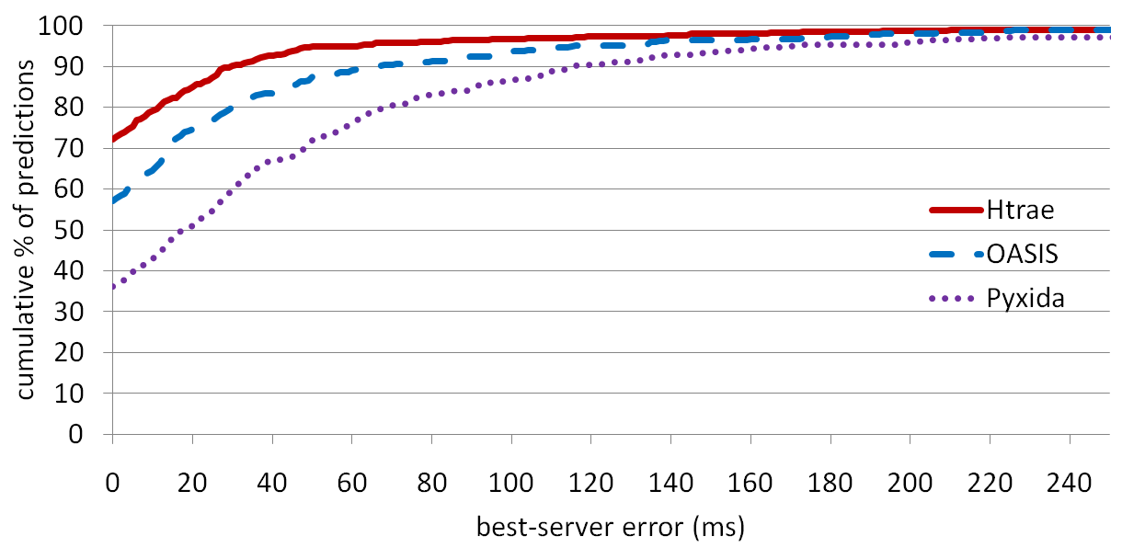
Comparison to deployed systems
Only considering address pairs OASIS makes a prediction for
Geolocation + NCS is better than straight geolocation

Slide 34
Evaluation, part 3:
How effective are predictors at client-server game matchmaking?

Slide 35
Limited probing

Slide 36
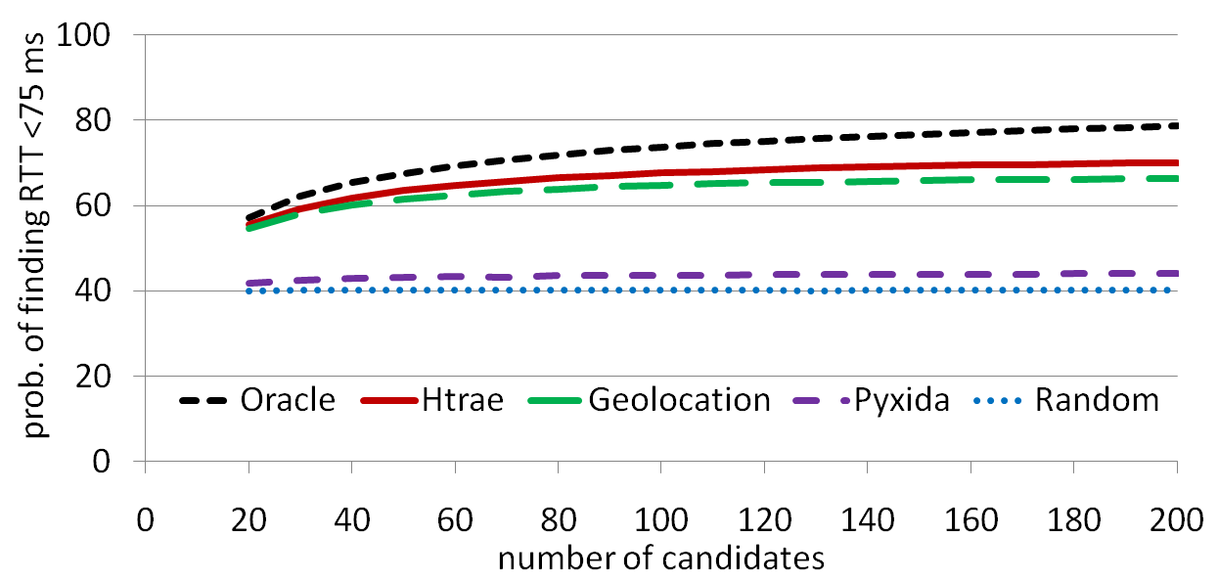
Limited probing
Htrae much better than random, which is used today
Htrae also better than Pyxida and geolocation

Slide 37
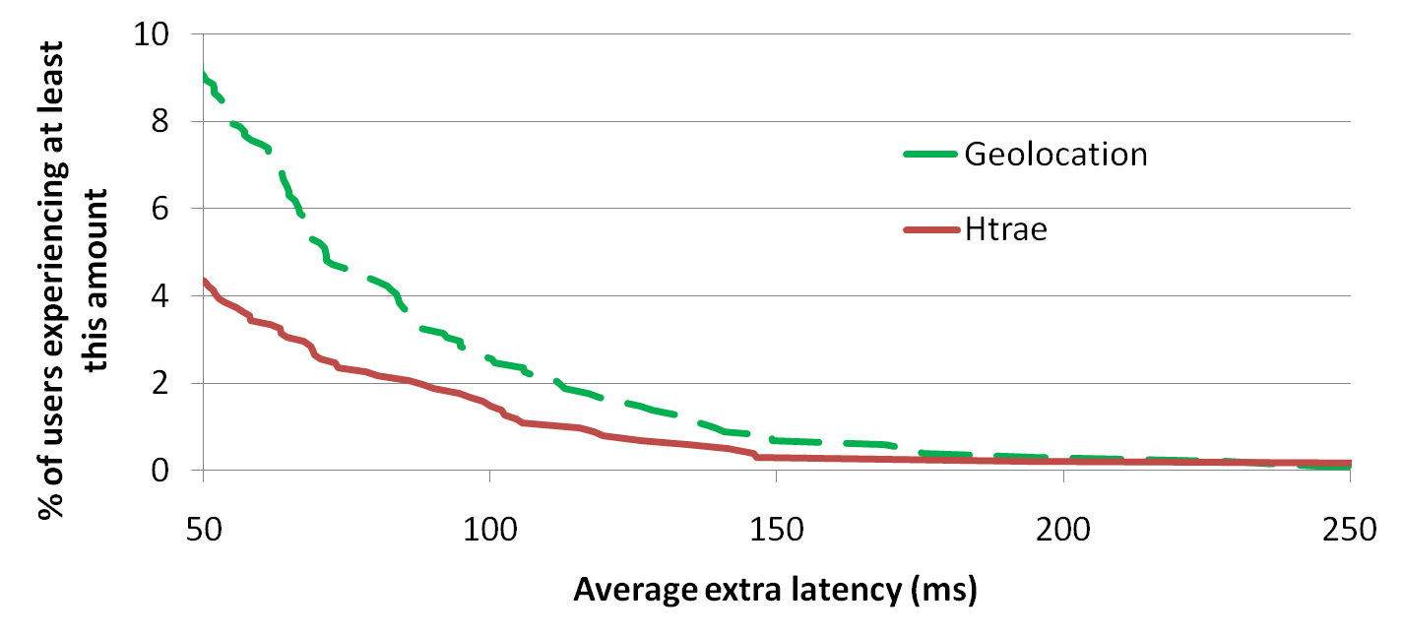
Limited probing
Geolocation is almost as good as Htrae overall, but
at least 50% more users experience consistently bad results

Slide 38
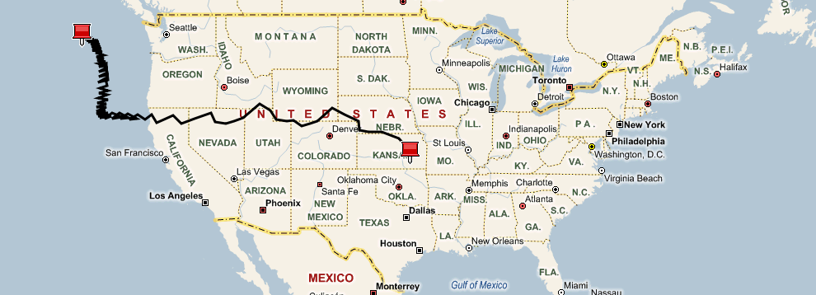
Deployment
Errors in geolocation are corrected by the NCS component
Notes:
Explain why it wound up west of Redmond.

Slide 39
Outline
Motivation
Overview
Background
Design
Evaluation
Related work
Concluding remarks

Slide 40
Related work
Network coordinate systems
  Landmark-based: GNP [Ng and Zhang 2003], Lighthouse [Pias et al. 2003], PIC [Costa et al. 2004], ICS [Lim et al. 2005], virtual landmarks [Tang and Crovella 2003]
  Decentralized: Vivaldi [Dabek et al. 2004], Pyxida [Ledlie et al. 2007], Hyperbolic Vivaldi [Lumezanu and Spring 2008]
  Some tried spherical coordinates and found them to not work well; they work for us due to geographic bootstrapping
Geolocation: NetGeo [Moore et al. 2000], IP2Geo [Padmanabhan and Subramanian 2001], OASIS [Freedman et al. 2006]
Graph representation of the Internet: IDMaps [Francis et al. 2001], clustered tracers [Theilmann and Rommel 2000], iPlane [Madhyastha et al. 2006], iPlane Nano [Madhyastha et al. 2009]
Large-scale evaluation: Pyxida [Ledlie et al. 2007]
Notes:
Don’t spend too long on this slide.

Slide 41
Concluding remarks
Latency prediction is important in game matchmaking and other P2P systems
Network coordinates and geolocation have disadvantages allayed by combining them
  Geographic bootstrapping
A large, widespread real-system trace shows:
  Htrae outperforms state-of-the-art systems
  Symmetric updates, AS corrections, and TIV avoidance improve performance

